Slide 1
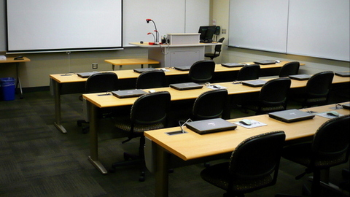
Making the Undergraduate Classroom More Accessible
Kimberly R. Bergendahl,
Associate Professor in Residence
Department of Political Science, University of Connecticut
February 26, 2024
This Photo by Unknown Author is licensed under CC BY

Slide 2
POLS DEI Committee
Jeremy Pressman, Professor and Chair of DEI Committee, POLS
Oksan Bayulgen, Professor and Department Head, POLS
Paul Herrnson, Professor, POLS
Kimberly R. Bergendahl, Associate Professor in Residence, POLS
Beth Ginsberg, Associate Professor in Residence, POLS
M. Aynal Haque, Ph.D. Candidate, POLS
Yeijie Kim, Ph.D. Candidate, POLS
Sandy Grande, Professor and Former Chair of DEI Committee, POLS

Slide 3
CLAS Accessibility Fellowship (2022-2023)- and Beyond!
Application announcement in Spring of 2022
Kate Capshaw, Associate Dean for Diversity, Equity and Inclusion,
Lyn Trible, Associate Dean for Humanities and Undergraduate Affairs
Faculty Fellows and Graduate Assistant
R. Holly Fitch, Professor, Psychological Sciences: Advocates funding for professional captioning of course video content for deaf and hard of hearing students
Erin Scanlon, Assistant Professor in Residence, Physics: Focuses on accessibility for STEM students with disabilities; lead a semester-long Learning Community for faculty in the Spring of 2023
Josh Hinostroza, Graduate Assistant: Research on disability; organized events

Slide 4
Kimberly R. Bergendahl, Associate Professor in Residence
My Project for the CLAS Accessibility Faculty Fellows Program: Assessed Accessibility in Graduate Programs in CLAS
Conducted interviews with Directors of Graduate Studies and graduate students in different divisions in CLAS
Met with key actors in Graduate School: Cinnamon Adams, then Director of Graduate Student and Postdoctoral Support and Stuart Duncan, Director of Programming and Diversity Recruitment
Reviewed research and resources on graduate programs and disability/Connected with Campus Experts: Brenda Brueggemann, Professor, English; Audrey Silva, Director, UCONN Communication Access and Interpreting Services; and, Christine Wenzel, Executive Director, Center for Students with Disabilities
Organized events based on feedback from graduate students:
Karen Skudlarek, ITS Accessibility Coordinator, “IT Accessibility for Graduate Students”
Lisa Famularo, Assistant Director of Equity and Inclusion, Center for Career Development and Ryan Bangham, ADA Accommodations Case Manager: “Making the Transition Into the Workplace: Search Tips and Information on Rights to Accessibility for Graduate Students in CLAS”
Currently working on article on Disability and Graduate Programs

Slide 5
Where “Accessibility” Falls Within “DEI”
Diversity
Differences in Learning and Abilities
Intersectionality
Equity
Accommodations “to level the playing field”
Inclusion
Accessibility (access to course and access to instructor)

Slide 6
Accommodations v. Accessibility
Accommodations are the means to achieving accessibility
CSD defines “accommodations” as:
Adjustments, modifications, aids, or services designed to provide equal access and remove disadvantages
Must be both reasonable and appropriate
Determined through interactive process in CSD office
Exceptions are made if the request presents a fundamental alteration to a course
Credit: Christine Wenzel, Executive Director, Center for Students With Disabilities

Slide 7
This Presentation Will Cover:
Brief overview of disability rights: Law and culture
Current data from CSD (credit to Christine Wenzel, Executive Director)
Some of the top questions faculty ask in relation to accommodations (CLAS Accessibility Faculty Fellows)
Best practices for making the undergraduate classroom more accessible: Universal Design for Learning Model (UDL)
For further consideration/Q&A

Slide 8
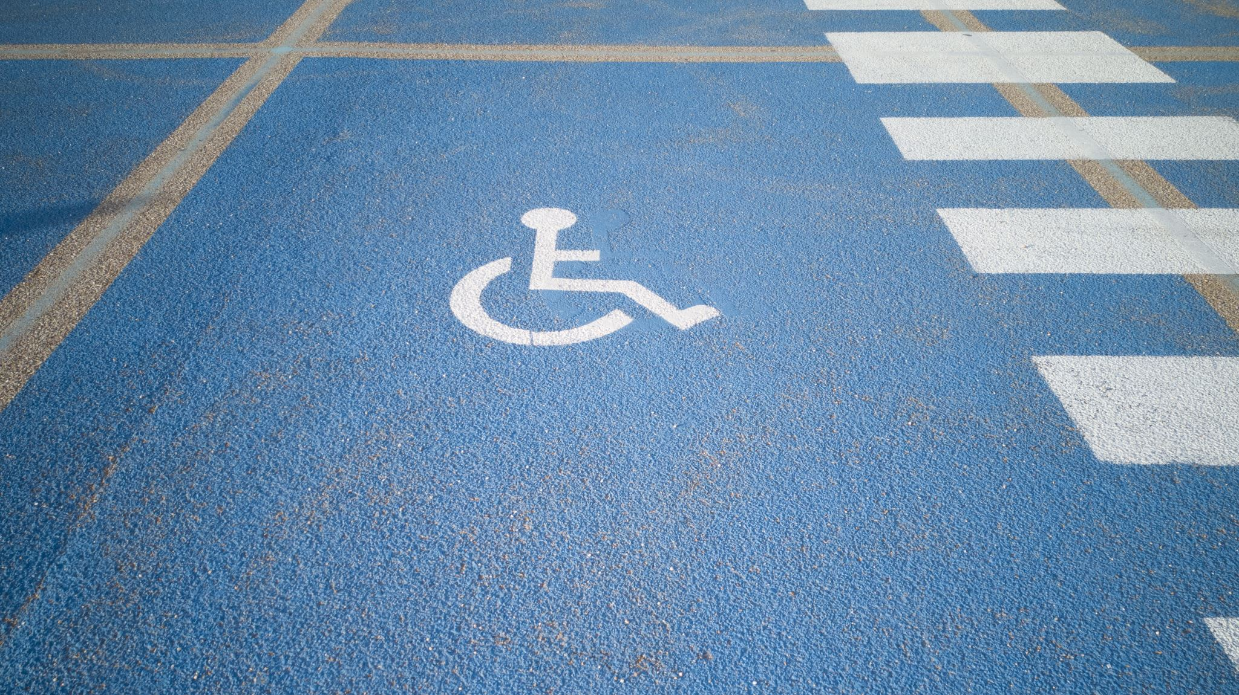
Disability Rights

Slide 9
Federal Laws
1973
Section 504 of the Rehabilitation Act of 1973
1990
The Americans with Disabilities Act (ADA) of 1990
1975, 1990, 2004
Individuals with Disabilities Education Act (IDEA) (as reauthorized)
2008
Amendments to the ADA (ADAA) in 2008

Slide 10
Courts as Agents of “Social Change?”
Lawsuits have often defined the types of accommodations requests we receive
Example: “Extra Time”
No definitive research on effectiveness of this accommodation (Holmes and Silvestri, 2019)
Some faculty try to get around the accommodation by saying that extra time has been added, yet applies to all in a class
Cannot do that!

Slide 11
Cultural Change?
Earlier studies noted the reluctance of college students to disclose disability due to fear of stigma (see Denhart, 2008)
Grad students are even less likely to report due to stigma (see Damiani and Harbour, 2015; Jain et al., 2020; Pearson and Boskovich, 2019)
Have there been changes in disclosure since 2008?
Data show significant increase in accommodations requests from undergraduates who have disclosed a disability, especially after 2020, at UConn
Does this mean students are less likely to fear that “stigma?”
What can faculty do to foster a culture of accessibility?

Slide 12
Current Data on Accommodations Requests
Christine Wenzel, Executive Director, Center for Students With Disabilities

Slide 13
Center for Students with Disabilities (CSD)
What it looked like in 1991
What it is like today….

Slide 14
Students Served by CSD
Credit: Christine Wenzel, Executive Director, Center for Students With Disabilities
Notes:
Averaging 27% year over year increase last 3 years; previously CSD averaged a 7% increase YOY
20% increase in the number of students served in 2021-2022 (5,309) compared to 2020-2021 (4,431).
58% increase in the number of new referrals in Fall 2021 (1,480) compared to Fall 2020 (934).

Slide 15
Students with Disabilities
Category* | 2020-2021 | 2021-2022 | %Increase/Decrease
Attention Deficit/Hyperactivity Disorder | 1,198 | 1,490 | 24% increase
Autism Spectrum Disorder | 169 | 218 | 29% increase
Chronic Health Conditions | 1,690 | 1,937 | 14% increase
Deaf/Hard of Hearing | 77 | 85 | 10% increase
Learning & Cognitive Disorders | 564 | 634 | 12% increase
Neurological Conditions | 537 | 626 | 16% increase
Physical Disabilities | 290 | 475 | 64% increase
Psychiatric Disabilities | 2,195 | 2,732 | 24% increase
Visual Disabilities | 91 | 103 | 13% increase
*Many students report more than one condition
Credit: Christine Wenzel, Executive Director, Center for Students With Disabilities

Slide 16
Regional Campus Students
Campus | 2020-2021 | 2021-2022 | %Increase/Decrease
Avery Point | 74 | 77 | --
Hartford | 242 | 318 | 31% increase
Stamford | 260 | 340 | 31% increase
Waterbury | 69 | 88 | 27% increase
Social Work | 40 | 58 | 45% increase
UCHC | Not reported | 29 | --
Total | 685 | 910 | 33% increase
Credit: Christine Wenzel, Executive Director, Center for Students With Disabilities

Slide 17
Student Contact Hours – Spring 2022
Disability Category | # of Contacts | Regular Hours | Enhanced Hours (Beyond Access) | Total Hours
Attention Deficit/Hyperactivity Disorder | 17,293 | 1,157 | 832 | 1,989
Autism Spectrum Disorder | 3,337 | 181 | 514 | 695
Chronic Health Conditions | 14,800 | 1,039 | 569 | 1,608
Deaf/Hard of Hearing | 668 | 46 | 5 | 51
Learning & Cognitive Disabilities | 11,585 | 705 | 967 | 1,672
Neurological Disabilities | 6,960 | 501 | 212 | 713
Physical Disabilities | 4,784 | 350 | 143 | 493
Psychiatric Disabilities | 48,002 | 3,366 | 1,379 | 4,745
Visual Disabilities | 1,864 | 370 | 39 | 409
Totals | 109,293 | 7,715 | 4,660 | 12,375
Credit: Christine Wenzel, Executive Director, Center for Students With Disabilities

Slide 18
Types of Accommodations
Academic Adjustments
Accessible Transportation & Parking Accommodations
Alternate Media
Assistive Technology
Assistive Communication
Dining Accommodations
Reduced Course load
Residential Accommodations
Service & Emotional Support Animals (ESA’s)
Technology-based Notetaking
Testing Accommodations
Credit: Christine Wenzel, Executive Director, Center for Students With Disabilities
Notes:
Just for reference—CSD proctored 3768 exams at Storrs fall 2021-spring 2022
Academic adjustment—deadline extensions, attendance flex. For remote attendance, in spring 2022 CSD approved 45 students.

Slide 19
Frequently Asked Questions (The “FAQs Document”) CLAS Accessibility Faculty Fellows in Collaboration with CSD

Slide 20
“Can I know the reasons for the requests?”
Bunbury (2020) identified a barrier to the effectiveness to inclusive learning strategies- that is, the lack of knowledge of disability
Still, as CSD reminds us, the reason for an accommodation is privileged information and faculty cannot ask the student about it.

Slide 21
“Can’t we get accommodations letters before class begins?”
CSD encourages students to put in their requests as soon as possible, though that is not always possible
Conditions change which may warrant updates in accommodations

Slide 22
What can I do to minimize the number of accommodations requested? Are there specific examples of faculty strategies to provide a more inclusive environment?
YES!!!!

Slide 23
Best Practices for Making the Undergraduate Classroom More Accessible
Universal Design for Learning (UDL)

Slide 24
Consider This…
“The student in the wheelchair becomes less ‘different’ when the building designed with him in mind is altered to permit his access” (Martha Minow, Making All the Difference: Inclusion, Exclusion, and American Law, Cornell Univ. Press, 1990, p. 12)
ADA and other federal laws have been effective in re-creating physical structures, but what about “learning” spaces?

Slide 25
What is Universal Design for Learning (UDL)? From CAST.org (Center for Applied Special Technology):
Recognize that everyone has a different learning style
Representation: Create a welcoming environment; use assistive technologies; reconstruct the physical space
Action and Expression: Provide options for students to relay their understandings of course material
Engagement: Allow students to be risk-takers

Slide 26
How I Conceptualize UDL

Slide 27
1. “Representation”
Creating an Inclusive Classroom Environment

Slide 28
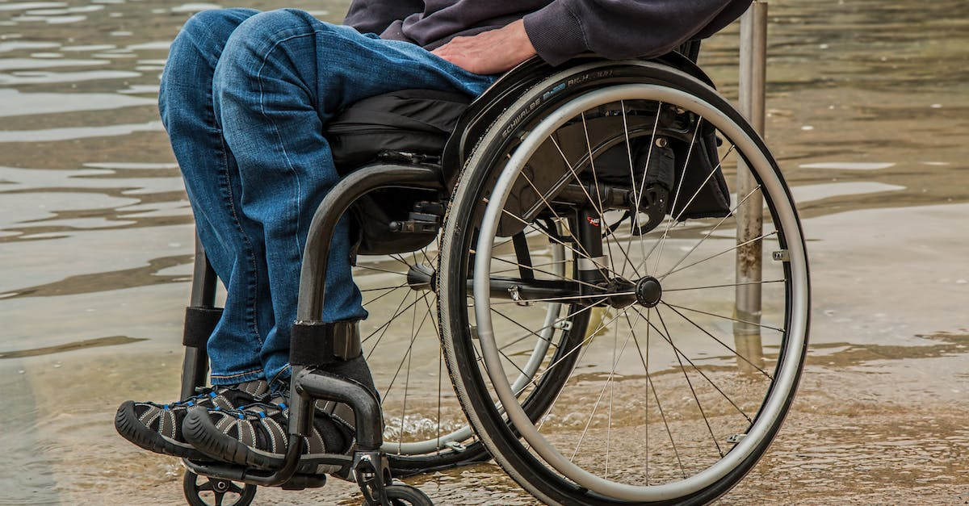
What’s in a Name?: How to Frame “Disability”
Disabled person
This Photo by Unknown Author is licensed under CC BY-ND
Woman in a wheelchair
From CUNY Academic Commons (Ferrigon, 2019):
Use “Person-First” language: “A person with a disability”
Notes:
From CUNY Academic Commons (Ferrigon, 2019): Use “Person-First” language: A person with a disability

Slide 29
“To Compliment?” or “To Complement?”
Consider when to “compliment” a person with a disability
Prefer subtle practices and reasonable accommodations that “complement” differences

Slide 30
Begin with a “Learning Survey”
Simmeborn, et al. (2013) note how open-ended questionnaires can provide insight into understanding students with disabilities
I recommend distributing a general survey to be completed on a voluntary basis right at the beginning of the semester
Questions may include:

Slide 31
Employ Various Methods for Relaying Course Information
Assistive Technologies:
Karen Skudlarek (ITS Accessibility Coordinator): Syllabus construction
Audrey Silva (Director, UCONN Communication Access and Interpreting Services): Interpreter Services
What You Can Do as the “Architect”:
Framing information on CSD in a way that is not just part of a list; make it clear that your class is accessible on your syllabus (may even note implementation of UDL)
Speak clearly; maintain consistent speed of delivery
Take advantage of multi-media technology in the room (use projector, microphone, captions)
Consider fonts (size and color)
Use the accessibility checkers (see example; locate under “tools”)

Slide 32
Other Considerations for Classroom Space and Structure
Gillen (2015, p. 3) in “Access for All: Neuro-architecture and Equal Enjoyment of Public Facilities” notes how the ADA has helped those with physical disabilities, but not necessarily for those with cognitive disabilities or those who identify as neurodiverse.
Establish routines
Consider lighting and sound in a classroom
Seating preferences (may consider a seating chart to minimize distraction; guarantees seating for those with an accommodation)

Slide 33
2. “Action and Expression”
Offer options to students- especially effective for those whose conditions limit their ability to participate and/or require extra time to complete assignments

Slide 34
“Diverse Actions”: How Students Record and Respond to Lectures/Course Material
Use of laptops and other technologies for notetaking
“Class Participation”: Provide options in class (verbal and/or written submissions); use of discussion boards
Use of laptops in class can be controversial as it is a known distractor
Multiple assignments may increase faculty member’s workload

Slide 35
“Checkpoint Assessments”
Complete these outside of class via LMS
Frame it as “homework” and not “quiz”
Ensures extra time is provided which may be difficult to guarantee in a 50-minute class meeting

Slide 36
Allow Students to Drop Assignments
Pros
Cons
Counting the best, say, four out of six assessments accommodates those who miss a class
Relieves stress of all assignments factoring into final grade
Students who excel on, say, first four assessments become less motivated to learn remaining material
Burden of creating more assignments to create more options for drops

Slide 37
Provide Students with Choices
Allow students to select their preferences for projects (i.e. papers, group project, recorded presentations)
Create different versions of exams to accommodate students’ preferences (i.e. multiple-choice; essays; mixed format)

Slide 38
The “Pros” and “Cons” of Offering Choices
Pros
Cons
Accommodate different learning styles
Creates a more “democratic” classroom
More time devoted to creating different assignments
Difficult to manage with larger class sizes
Students still request accommodations

Slide 39
3. “Engagement”
Provide structure as well as opportunities for students to be risk-takers

Slide 40
“Engagement”: How to Reach Different Learners
Lecture Outlines on LMS for organization: Accommodates several learning styles and those who may require excessive absences
Presentation skills (i.e. be animated; use PowerPoint slides with graphics and animations) for visual learners and those with attention deficit disorders
Insert discussions into class time to assess comprehension and provide “breaks” from notetaking
Break class into groups, though acknowledge some students may prefer to work individually (i.e. as revealed in the “learning survey”)
Show videos with captions for relaying lessons through a “professional production” for better memory retention

Slide 41
Assessing “Engagement”
Pros
Cons
Lecture outlines provide organization and serve as study guides for all
Embedding “breaks” welcomed by all
Need to be prepared in advance (especially for creation of lecture outlines)
Not all faculty can be “animated”
Not all subjects can be relayed via different methods
Too much “spontaneity” may not work for those who thrive on routine

Slide 42
For Further Consideration

Slide 43
“Duality of UDL”: Provides both a “universal framework” while promoting choices
Students may not feel comfortable moving away from the “accommodations” model (see Hills, et al, 2022)
Advocate for institutionally-driven top-down implementation of UDL in universities (see Hills et al, 2022)
Foster a culture of embracing “disability”
Ensuring ”accessibility” in graduate programs may employ different strategies

Slide 44
Resources
Used in this Presentation
Recommended Resources
Alana Holmes and Robert Silvestri (2019). “Extra Time or Unused Time? What Data from a College Testing Center Tells Us About 50% Extra Time as an Accommodation for Students with Learning Disabilities” Psychological Injury and Law 12, pp. 7–16. https://doi.org/10.1007/s12207-019-09339-9
Bunbury, Stephen. 2020. “Disability in Higher Education – Do Reasonable Adjustments Contribute to an Inclusive Curriculum?” International Journal of Inclusive Education 24(9): 964–79. https://www.tandfonline.com/doi/full/10.1080/13603116.2018.1503347.
Damiani, Michelle L. and Wendy S. Harbour. 2015. “The Wizard Behind the Curtain: Teaching Experiences of Graduate Teaching Assistants with Disabilities at U.S. Universities.”
Innovative Higher Education 40(5): 399-413. https://doi.org/10.1007/s10755-015-9326-7
Denhart, Hazel. 2008. “Deconstructing Barriers: Perceptions of Students Labeled With Learning Disabilities in Higher Education.” Journal of Learning Disabilities 41(6): 483–97. http://journals.sagepub.com/doi/10.1177/002221940832115.
Hills, Melissa, et al. 2022. “Faculty Perspectives on UDL: Exploring Bridges and Barriers for Broader Adoption in Higher Education.” Canadian Journal for the Scholarship of Teaching and Learning 13(1). https://doi.org/10.5206/cjsotlrcacea.2022.1.13588.
Jain, Dhruv et al. October 26-28 2020. ”Navigating Graduate School with a Disability.” Assets ‘20. Virtual Event, Greece.
Pearson, Holly and Lisa Boskovich. 2019. “Problematizing Disability Disclosure in Higher Education: Shifting Towards a Liberating Humanizing Intersectional Framework.” Disability Studies Quarterly 39(1). https://doi.org/10.18061/dsq.v39i1.6001.
Simmeborn Fleischer, Ann, Margareta Adolfsson, and Mats Granlund. 2013. “Students with Disabilities in Higher Education – Perceptions of Support Needs and Received Support: A Pilot Study.” International Journal of Rehabilitation Research 36(4): 330–38.
Womack, Anne-Marie. 2017. “Teaching is Accommodation: Universally Designing Composition Classrooms and Syllabi.” College Composition and Communication 68(3): 494-525. https://www-jstor-org.ezproxy.lib.uconn.edu/stable/44783578?seq=17
https://www.jstor.org/stable/44783578
Center for Teaching Excellence at Boston College: https://cteresources.bc.edu/documentation/universal-design-for-learning/
Our own Brenda Brueggemann, Professor, Department of English, UConn
Dolmage, Jay T. 2017. Academic Ableism: Disability and Higher Education. Ann Arbor: University of Michigan Press.
Hamraie, Aimi. 2013. “Designing Collective Access: A Feminist Disability Theory of Universal Design.” Disability Studies Quarterly 33(4). https://doi.org/10.18061/dsq.v33i4.3871.
Our own Erin Scanlon, Assistant Professor in Residence, Department of Physics, Uconn- Avery Point
Our own Karen Skudlarek, ITS Accessibility Coordinator, UITS, UConn
Wilson, Jan Doolittle. 2017. “Reimagining Disability and Inclusive Education Through Universal Design for Learning.” Disability Studies Quarterly 37(2). https://doi.org/10.18061/dsq.v37i2.5417.

Slide 45
Thank You!
kimberly.bergendahl@uconn.edu

